Slide 1
Data Link Layer Part VI: IEEE 802.11 wireless LANs (“Wi-Fi”)

Slide 2
Characteristics of selected wireless links
200
802.11n
54
802.11a,g
802.11a,g point-to-point
5-11
802.11b
Data rate (Mbps)
.384
.056
Indoor
10-30m
Outdoor
50-200m
Mid-range
outdoor
200m – 4 Km
Long-range
outdoor
5Km – 20 Km

Slide 3
Wireless Link Characteristics
important differences from wired link ….
decreased signal strength: radio signal attenuates as it propagates through matter (path loss)
interference from other sources: standardized wireless network frequencies (e.g., 2.4 GHz) shared by other devices (e.g., phone); devices (motors) interfere as well
multipath propagation: radio signal reflects off objects ground, arriving ad destination at slightly different times
…. make communication across (even a point to point) wireless link much more “difficult”

Slide 4


Wireless network characteristics
Multiple wireless senders and receivers create additional problems (beyond multiple access):
A
B
C
C
A’s signal
strength
C’s signal
strength
B
A
Hidden terminal problem
B, A hear each other
B, C hear each other
A, C can not hear each other means A, C unaware of their interference at B
space
Signal attenuation:
B, A hear each other
B, C hear each other
A, C can not hear each other interfering at B

Slide 5
IEEE 802.11 Wireless LAN
802.11b
2.4-5 GHz unlicensed spectrum
up to 11 Mbps
direct sequence spread spectrum (DSSS) in physical layer
802.11a
5-6 GHz range
up to 54 Mbps
802.11g
2.4-5 GHz range
up to 54 Mbps
802.11n: multiple antennae
2.4-5 GHz range
up to 200 Mbps
all use CSMA/CA for multiple access
all have base-station (infrastructure mode) and ad-hoc network versions

Slide 6






802.11 LAN architecture
wireless host communicates with base station
base station = access point (AP)
Basic Service Set (BSS) (aka “cell”) in infrastructure mode contains:
wireless hosts
access point (AP): base station
ad hoc mode: hosts only
Internet
hub, switch
or router
BSS 1
BSS 2

Slide 7
802.11: Channels, association
802.11b: 2.4GHz-2.485GHz spectrum divided into 11 channels at different frequencies
AP admin chooses frequency for AP
AP has a name (SSID) and MAC address
interference possible: channel can be same as that chosen by neighboring AP!
host: must associate with an AP
may perform authentication
will typically run DHCP to get IP address in AP’s subnet

Slide 8
802.11: passive/active scanning
BBS 1
BBS 2
BBS 1
BBS 2
1
AP 2
AP 1
1
1
AP 2
AP 1
2
2
2
3
3
4
H1
H1
passive scanning:
beacon frames sent from APs
association Request frame sent: H1 to selected AP
association Response frame sent from selected AP to H1
active scanning:
Probe Request frame broadcast from H1
Probe Response frames sent from APs
Association Request frame sent: H1 to selected AP
Association Response frame sent from selected AP to H1

Slide 9




IEEE 802.11: multiple access
avoid collisions: 2⁺ nodes transmitting at same time
802.11: CSMA - sense before transmitting
don’t collide with ongoing transmission by other node
802.11: no collision detection!
difficult to receive (sense collisions) when transmitting due to weak received signals (fading)
can’t sense all collisions in any case: hidden terminal, fading
goal: avoid collisions: CSMA/C(ollision)A(voidance)
A
B
C
C
B
A’s signal
strength
C’s signal
strength
A
space

Slide 10
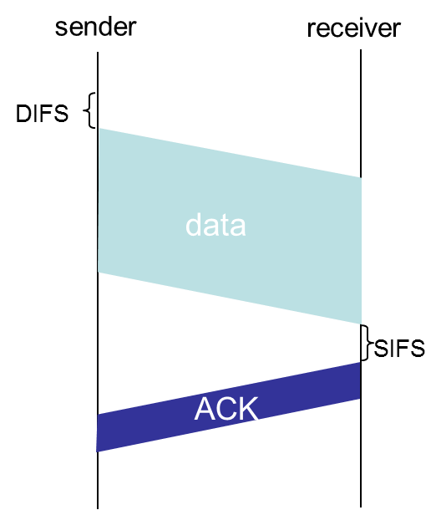
IEEE 802.11 MAC Protocol: CSMA/CA
802.11 sender
1 if sense channel idle for DIFS (Distributed Inter-frame Space) then
transmit entire frame (no CD)
2 if sense channel busy then
start random backoff time
timer counts down while channel idle, stops otherwise
transmit when timer expires
if no ACK, increase random backoff interval, repeat 2
802.11 receiver
- if frame received OK
return ACK after SIFS (Short Inter-frame Spacing)(ACK needed due to hidden terminal problem)

Slide 11
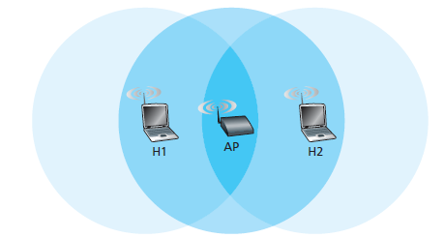
Hidden Terminal Example
H1 is transmitting a frame and halfway through H1’s transmission, Station H2 wants to send a frame to the AP.
H2, not hearing the transmission from H1, will first wait a DIFS interval and then transmit the frame, resulting in a collision.
The channel will be wasted during the entire period of H1’s transmission as well as during H2’s transmission.

Slide 12
Avoiding collisions (more)
idea: allow sender to “reserve” channel rather than random access of data frames: avoid collisions of long data frames
sender first transmits small request-to-send (RTS) packets to AP using CSMA
Indicates the total time required to transmit the DATA frame and the acknowledgment (ACK) frame
RTSs may still collide with each other (but they’re short)

Slide 13
Avoiding collisions (more)
BS broadcasts clear-to-send CTS in response to RTS
CTS frame:
gives the sender explicit permission to send
instructs the other stations not to send for the reserved duration.
CTS heard by all nodes
sender transmits data frame
other stations defer transmissions
avoid data frame collisions completely
using small reservation packets!

Slide 14


Collision Avoidance: RTS-CTS exchange
A
B
AP
RTS(B)
RTS(A)
reservation collision
RTS(A)
CTS(A)
CTS(A)
DATA (A)
defer
time
ACK(A)
ACK(A)

Slide 15
802.11 frame: addressing
2
2
6
6
6
2
6
0 - 2312
4
frame
control
duration
address
1
address
2
address
3
seq
control
address
4
payload
CRC
Address 4: used only in ad hoc mode
Address 1: Destination MAC address
of wireless host or AP
Address 3: MAC address
of router interface to which AP is attached
Address 2: Source MAC address
of wireless host or AP transmitting this frame

Slide 16
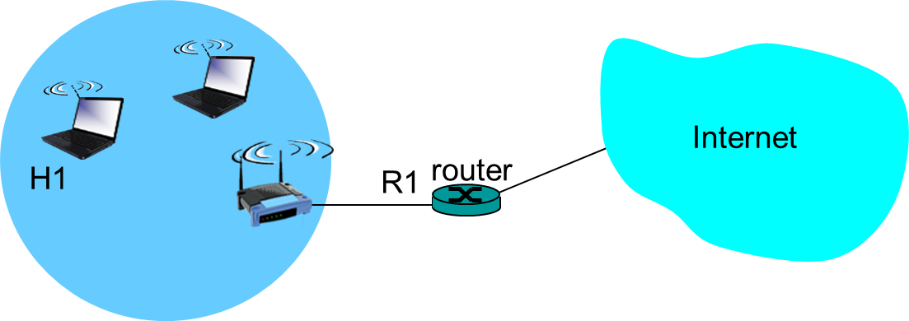
802.11 frame: addressing
Sending a datagram from the router interface R1 to the wireless Station H1:
ARP to determine the MAC address of H1
Sends Ethernet Frame: Source MAC: R1, Dest MAC: H1
AP: 802.3➔802.11
Address1: H1 MAC, Address2: AP MAC, Address3=R1 MAC

Slide 17
802.11 frame: addressing
Sending a datagram H1 to the router interface R1
Internet
H1
R1
router
R1 MAC addr H1 MAC addr
dest. address
source address
802.3 frame
AP MAC addr H1 MAC addr R1 MAC addr
address 1
address 2
address 3
802.11 frame

Slide 18
802.11 frame: more
frame seq #
(for RDT) (Reliable Data Transmission)
duration of reserved
transmission time (RTS/CTS)
2
2
6
6
6
2
6
0 - 2312
4
frame
control
duration
address
1
address
2
address
3
seq
control
address
4
payload
CRC
2
2
4
1
1
1
1
1
1
1
1
Protocol
version
Type
Subtype
To
AP
From
AP
More
frag
Retry
Power
mgt
More
data
WEP
Rsvd
frame type
(RTS, CTS, ACK, data)

Slide 19
Data Link Layer Part VI: IEEE 802.11 wireless LANs (“Wi-Fi”)

